Slide 1
ITS HR/PAYROLL
Session 53 Automated Statutory Reporting (COIDA, UIF, SKILLS)
Presented by Allie de Nysschen

Slide 2
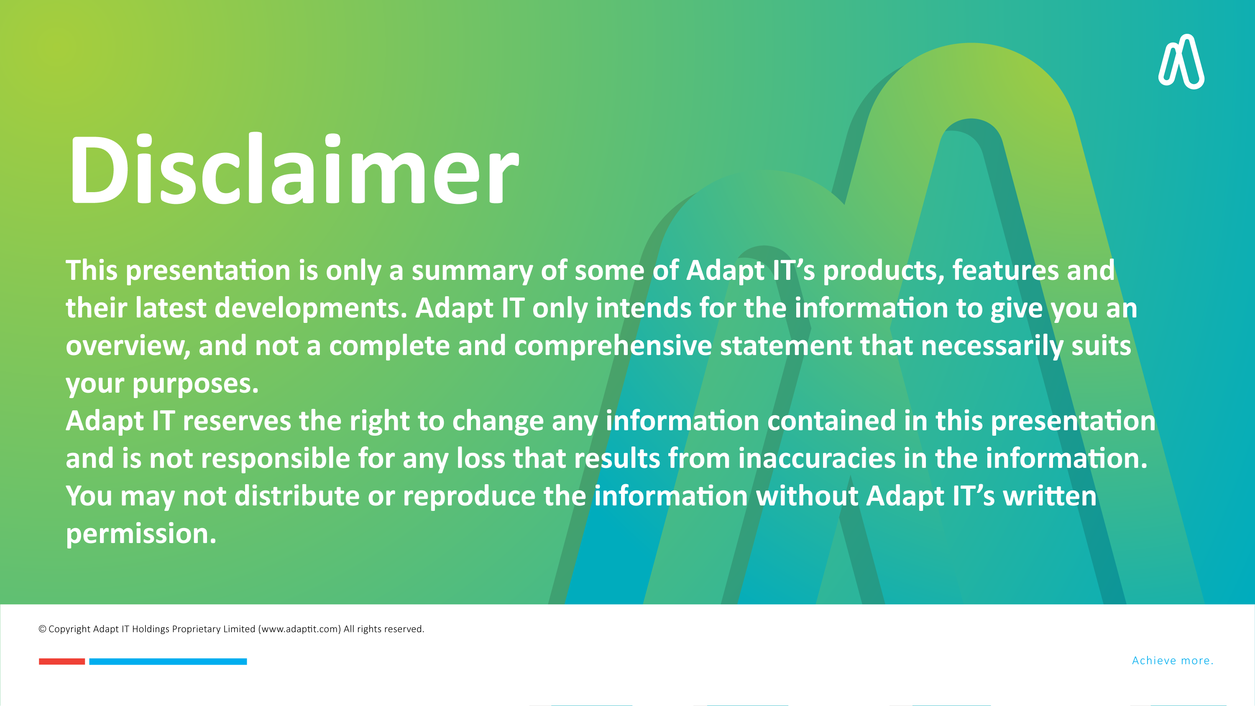
How is the system currently Maintained for COIDA, UIF and SKILLS
How did Adapt IT Automate the process
Prerequisites to Implement this Development
How to create a new ED Code from an existing active ED Code
How is COIDA, UIF and SKILLS calculated

Slide 3

How is the system currently Maintained for COIDA, UIF and SKILLS?
How did Adapt IT Automate the process?
Prerequisites to Implement this Development
UIF
COIDA
SKILLS
How to create a new ED Code from an existing active ED Code?
How is COIDA, UIF and SKILLS calculated?
Table of contents

Slide 4
How is the system currently Maintained for COIDA, UIF and SKILLS?

Slide 5

Automated Statutory Reporting (COIDA, UIF and SKILLS),
How is the system currently maintained for COIDA, UIF and SKILLS
COIDA?
Adapt IT use to notify You the client of the relevant change.
Then you the client had to make sure that you have corrected the relevant ED codes in {FPRG-6} and {FPRG-7}

Slide 6
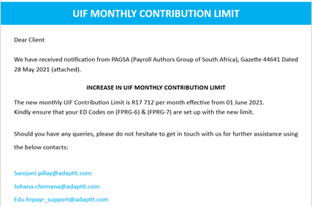
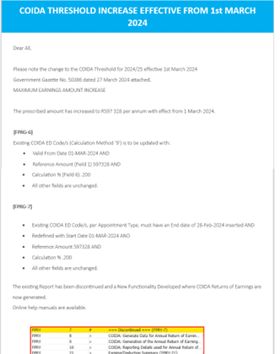
Automated Statutory Reporting (COIDA, UIF and SKILLS),

Slide 7
How did Adapt IT Automate the process?

Slide 8
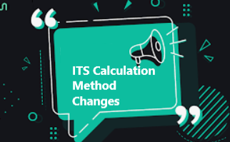


How was this process Automated?
Calculation methods B,V and 9 was enhanced to read values from a table
Future Maintenance
Calculation methods B,V and 9 was enhanced to use the values in the new tables to calculate amounts
Adapt IT will create tables containing new values for COIDA,UIF and SKILLS as and when changes are required by Government
The new tables will be date effective and will be send to all clients in new builds like the way IRP5 table changes are handled
The Payroll Calculation program was enhanced to accommodate the above changes
If clients have setup ED codes to look at the new table no more maintenance will be required from the users in future and these amounts should always be calculated correctly going forward using the tables that is maintained by Adapt IT, like the Tax tables
Table 9995 SKILLS
Table 9996 COIDA
Table 9994 UIF

Slide 9
Prerequisites to Implement this Development

Slide 10
Prerequisites to implement this Development
Build 100 has to be deployed on your test and production environments
Once Build 100 is deployed, if you Query {FPRG-4} table 9994 a new table for UIF will display.
The new ED Codes for UIF, SKILLS and COIDA EDUCATIONAL (Calc method B,V and 9)have to be created on {FPRG-7} for all Appointment types
Query the current existing record per Appointment type and click on create a new record and then Record /Duplicate, insert the new start date and New table and save the new record. A new record with the new table and start date will now be created and the old or previous active record will now be ended 1 day prior to the start date of the new record.
Repeat this process for all UIF,SKILLS and COIDA active ED Codes for all Appointment types
This will be the last time that you as a user will have to maintain UIF,SKILLS and COIDA
Going forward ADAPT IT will release any changes to these statutory deductions as part of the standard builds

Slide 11
UIF

Slide 12
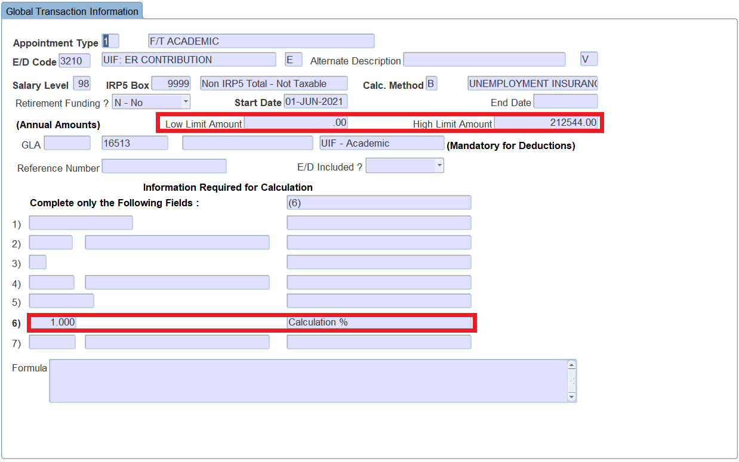
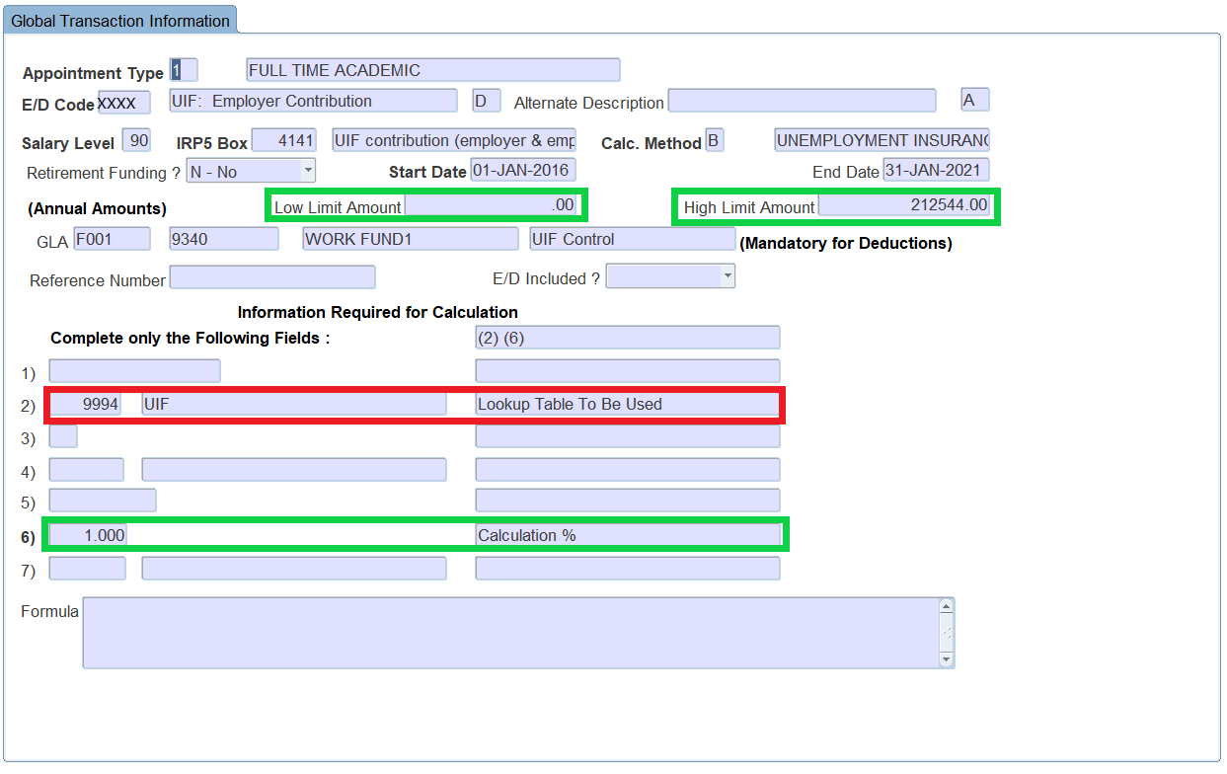
Prerequisites to implement this development – Client Action Required development
Current UIF Setup on {FPRG-7}
New UIF Setup on {FPRG-7}

Slide 13
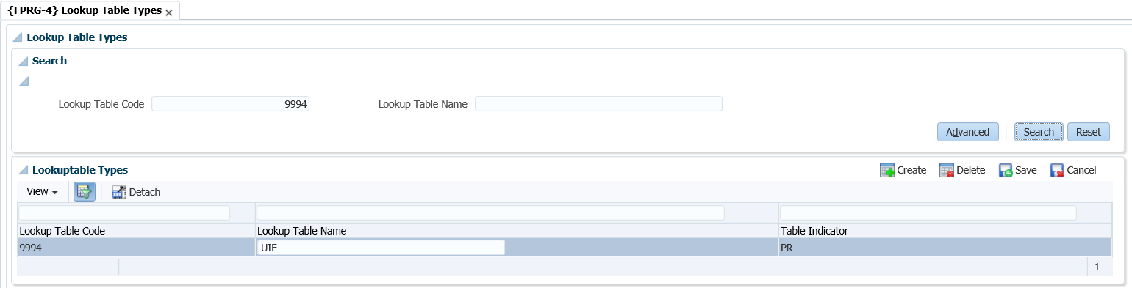
Prerequisites to implement this development – Client Action Required
New Table on {FPRG-4}

Slide 14
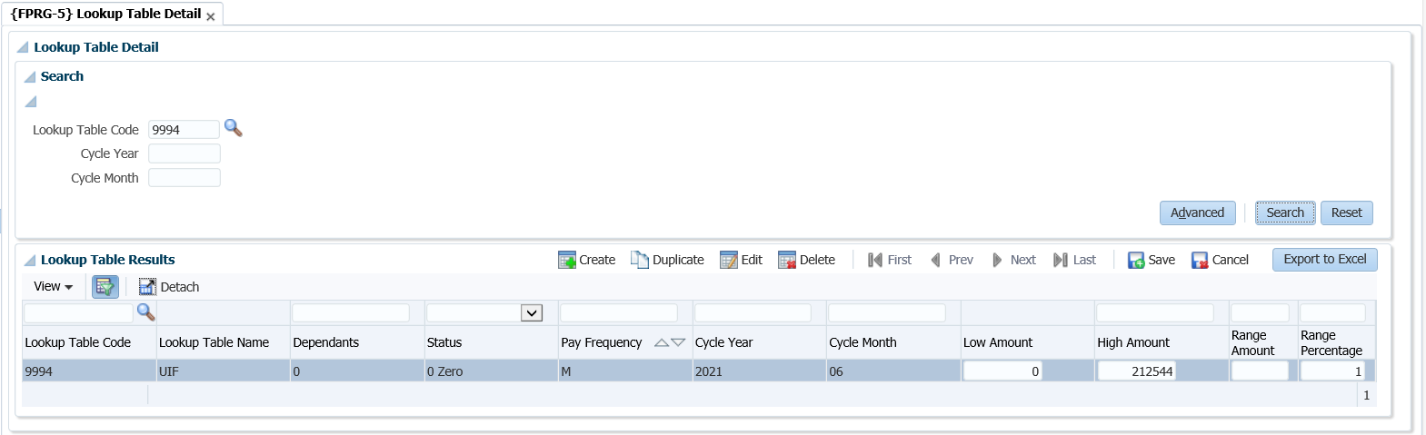
Prerequisites to implement this development – Client Action Required
Table values on {FPRG-5}

Slide 15
COIDA

Slide 16
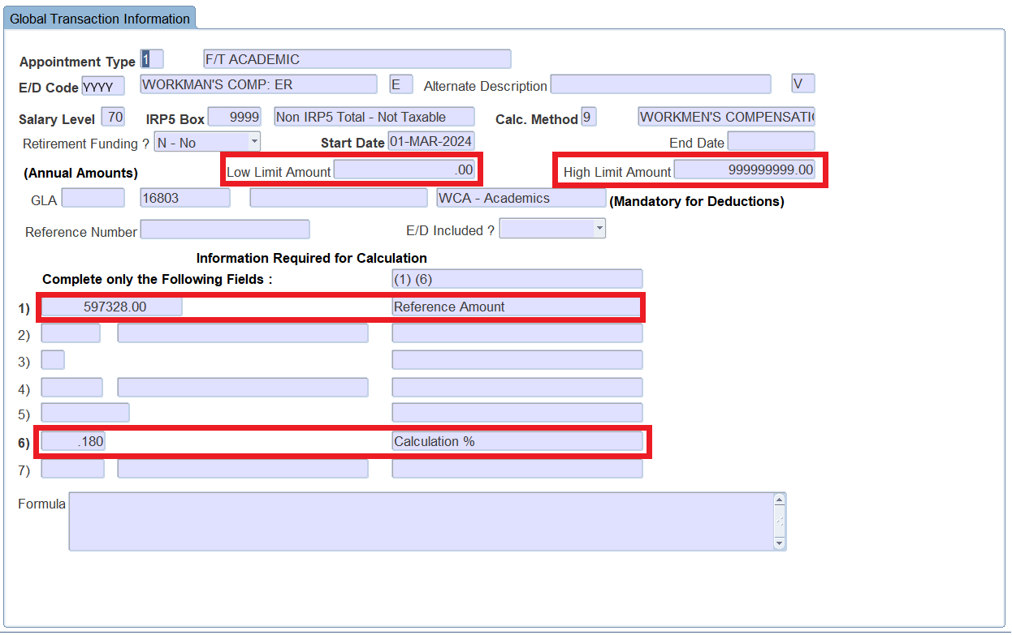
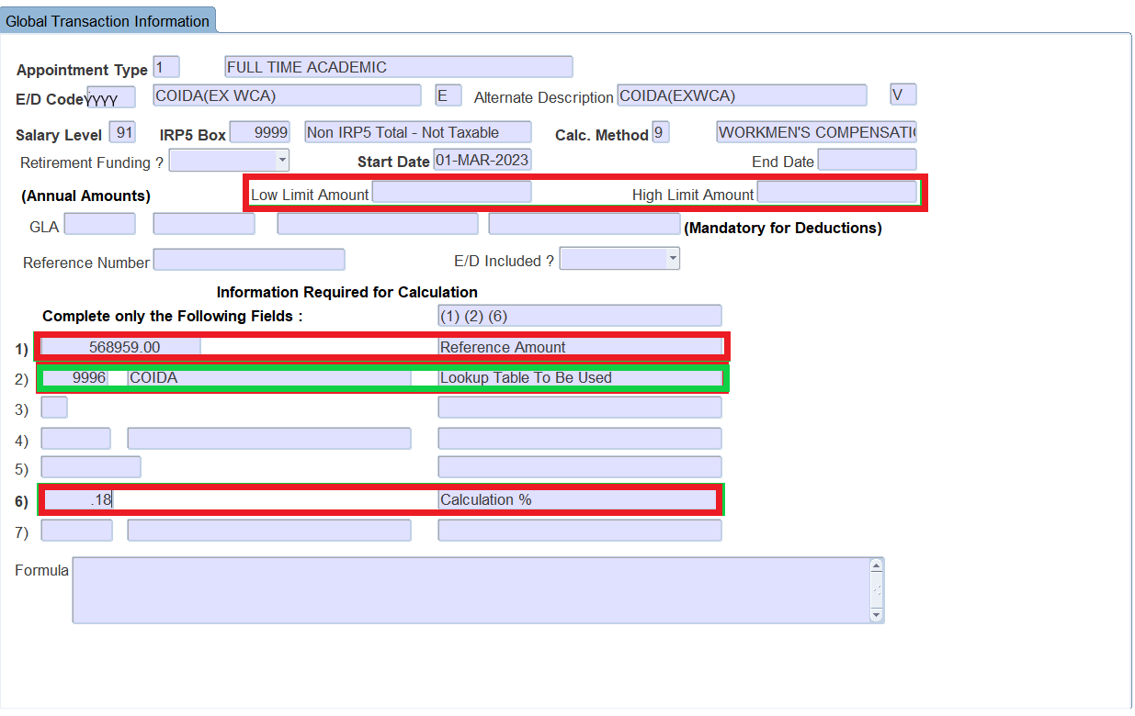
Prerequisites to implement this development – Client Action Required
Current COIDA Setup on {FPRG-7}
New COIDA Setup on {FPRG-7}

Slide 17
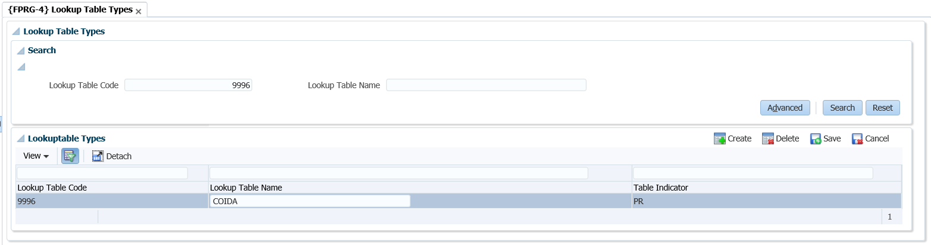
Prerequisites to implement this development – Client Action Required
New Table on {FPRG-4}

Slide 18
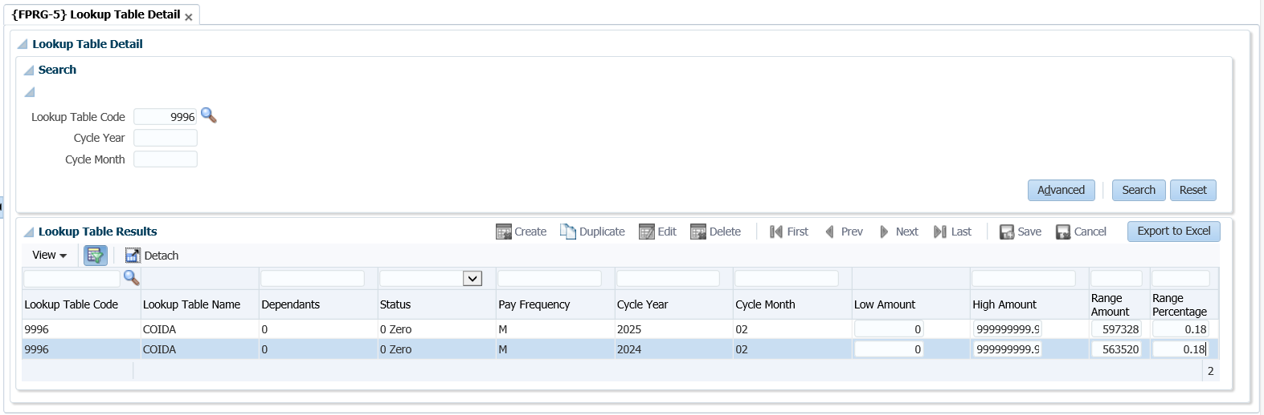
Prerequisites to implement this development – Client Action Required
Table values on {FPRG-5}

Slide 19
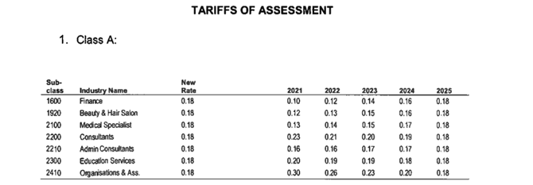
Prerequisites to implement this development – Client Action Required
Government Classification for COIDA purposes
EDUCATIONAL SERVICES, etc.
2300
Educational services including universities, colleges; trade schools; training ships; art
galleries; music schools; dancing academies or schools; nursery schools; charm schools,
libraries; museums; botanical gardens where these are not conducted in conjunction
with any other undertaking or business.

Slide 20
SKILLS

Slide 21
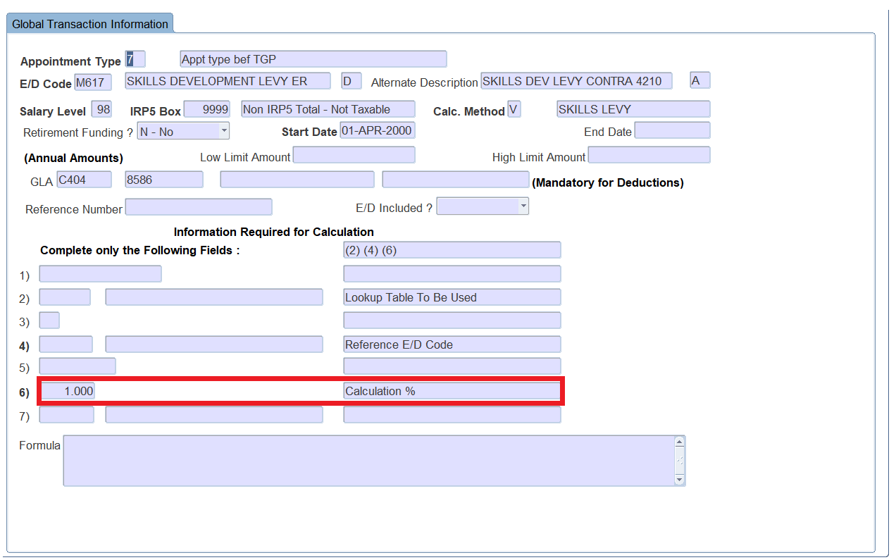
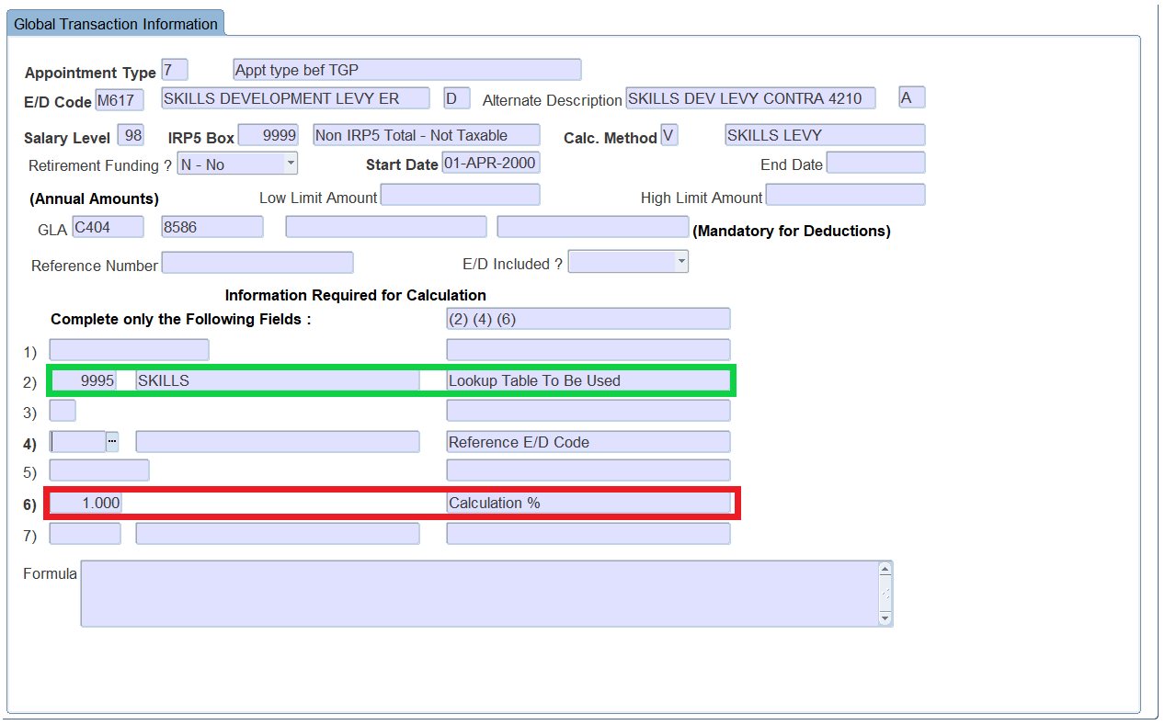
Prerequisites to implement this development – Client Action Required
Current SKILLS Setup on {FPRG-7}
New SKILLS Setup on {FPRG-7}

Slide 22
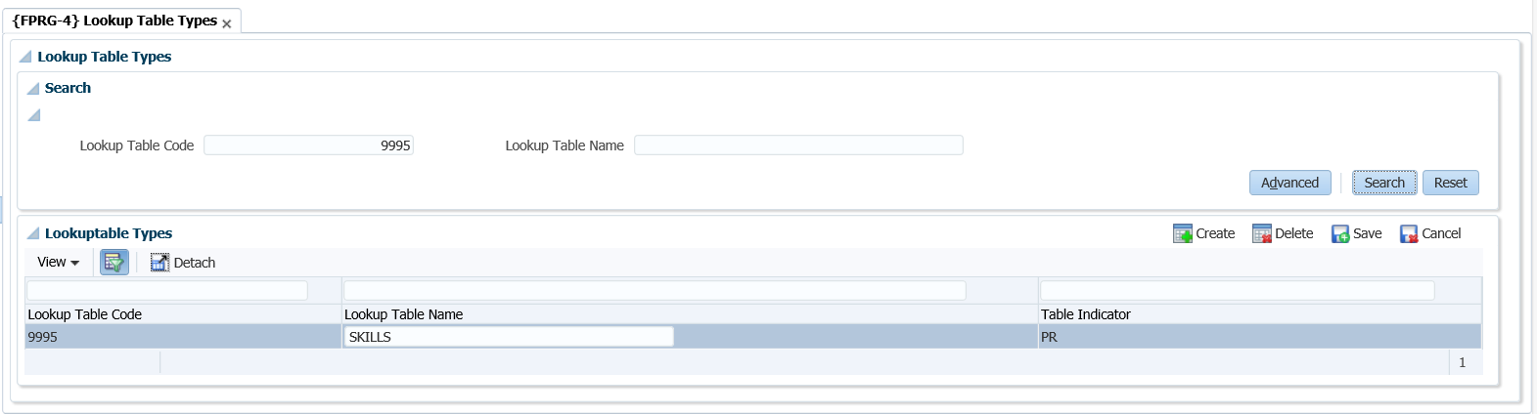
Prerequisites to implement this development – Client Action Required
New Table on {FPRG-4}

Slide 23
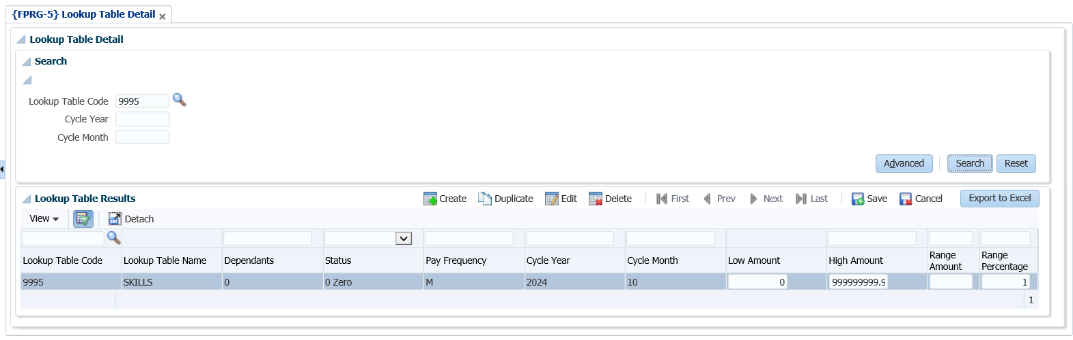
Prerequisites to implement this development – Client Action Required
Table values on {FPRG-5}

Slide 24
How to create a new ED Code from an existing active ED Code?

Slide 25
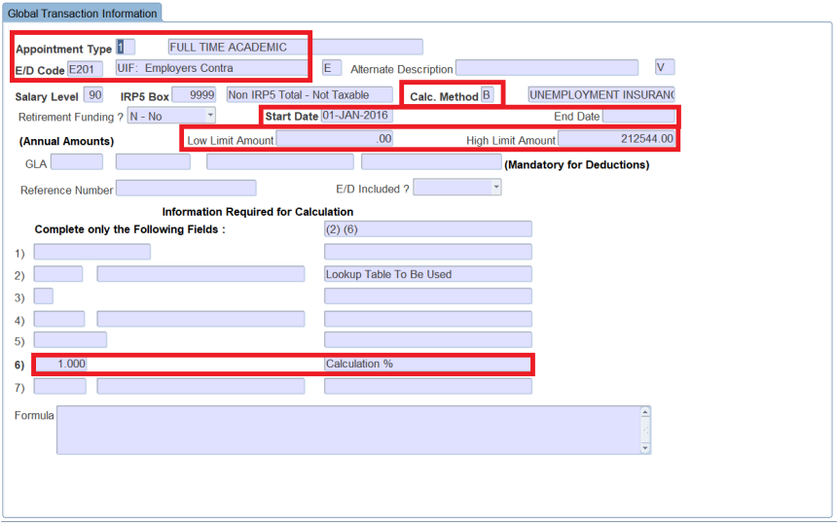
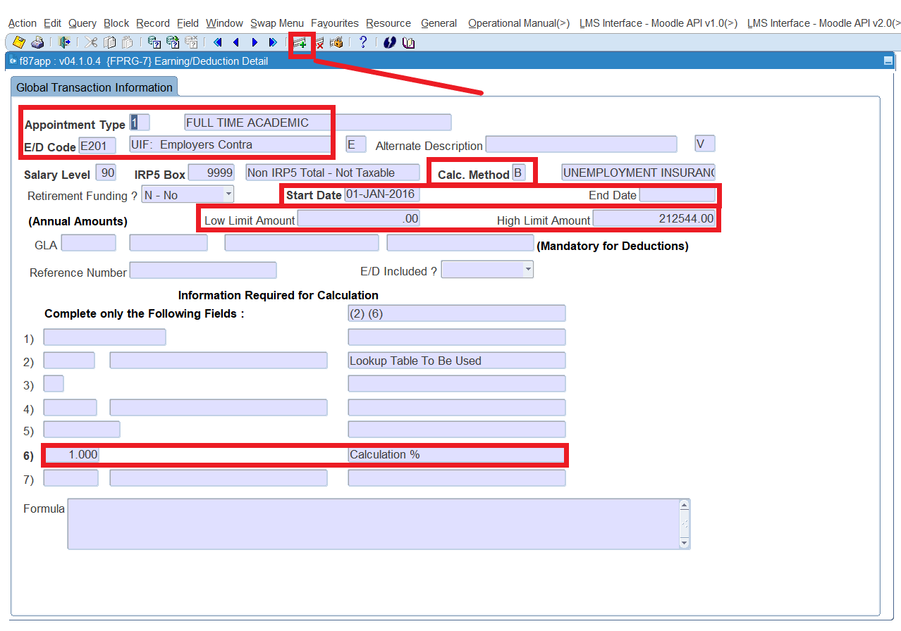
How to create a new ED Code from an existing active ED Code
Query the Existing active record on, {FPRG-7} for all Appointment Types
Now Click on create a new record for the same ed code on {FPRG-7}

Slide 26
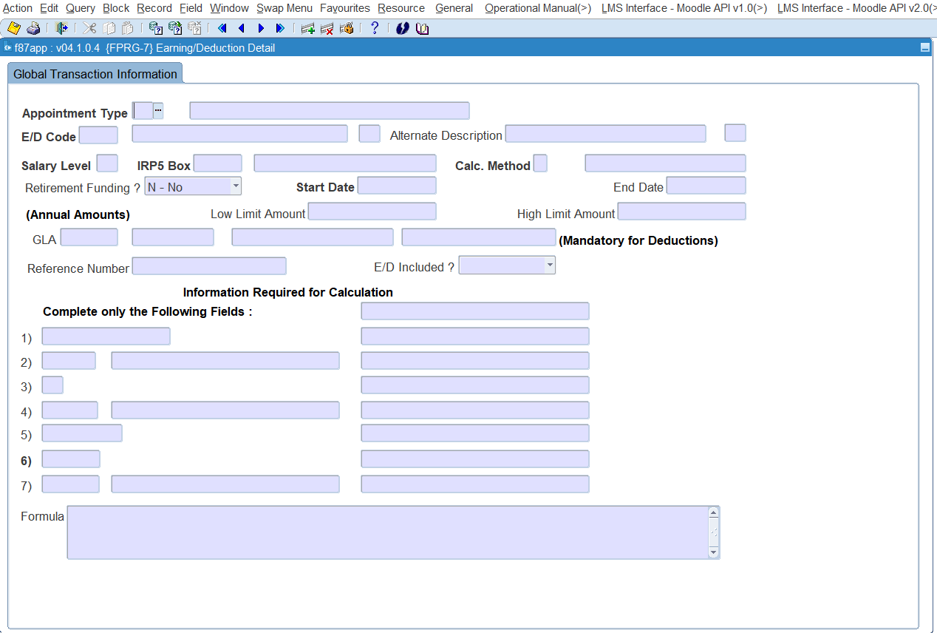
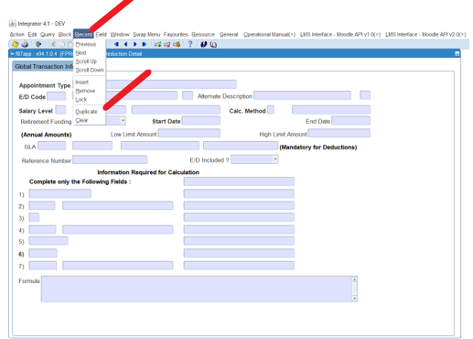
How to create a new ED Code from an existing active ED Code
Click on Duplicate Record, {FPRG-7}
Create a new record for the same ed code on {FPRG-7}

Slide 27
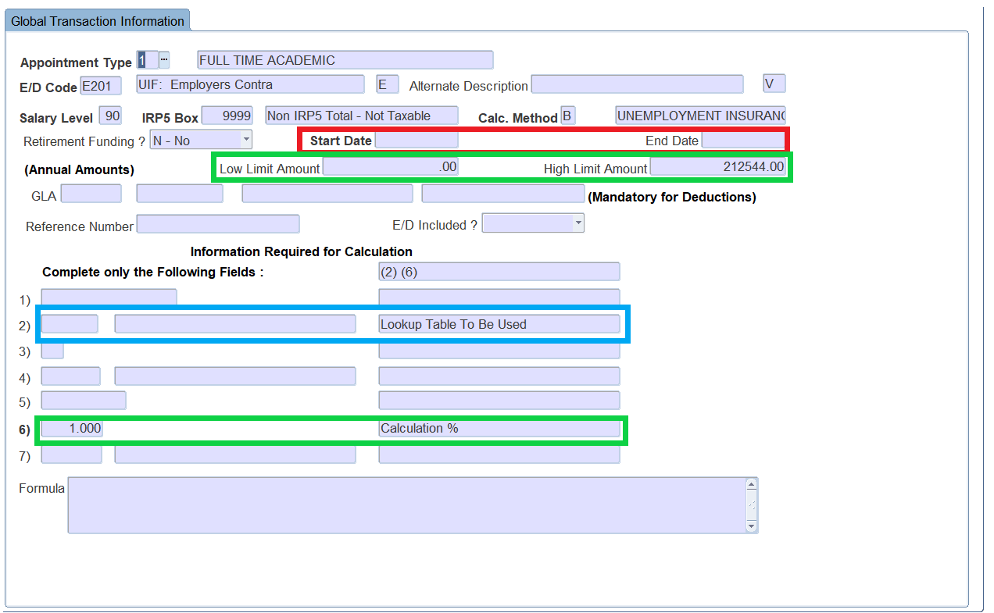
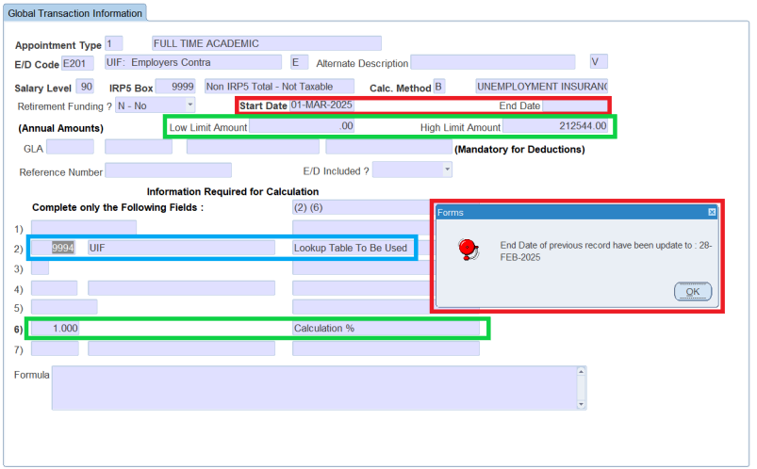
How to create a new ED Code from an existing active ED Code
The Duplicate Record is now displayed without dates, {FPRG-7}
Complete the effective start date and new table field and save {FPRG-7}

Slide 28
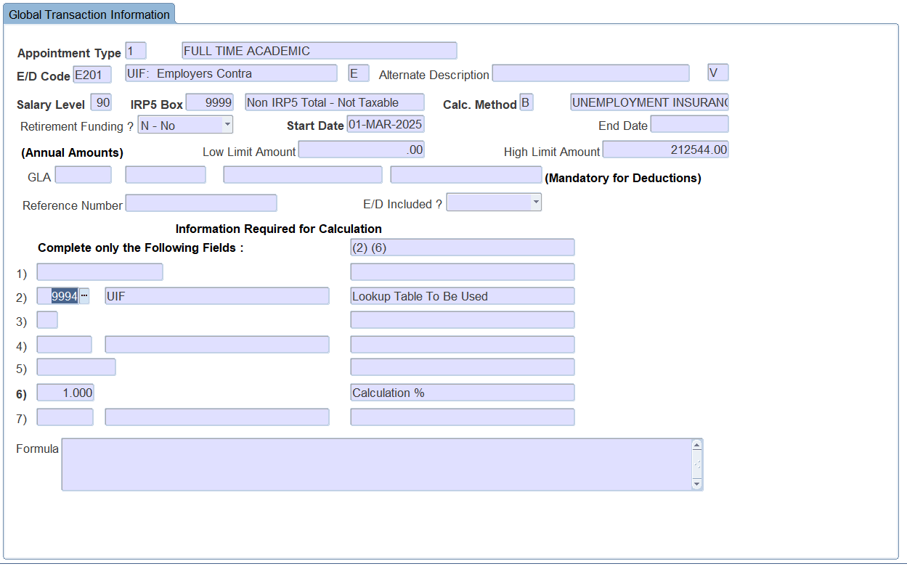
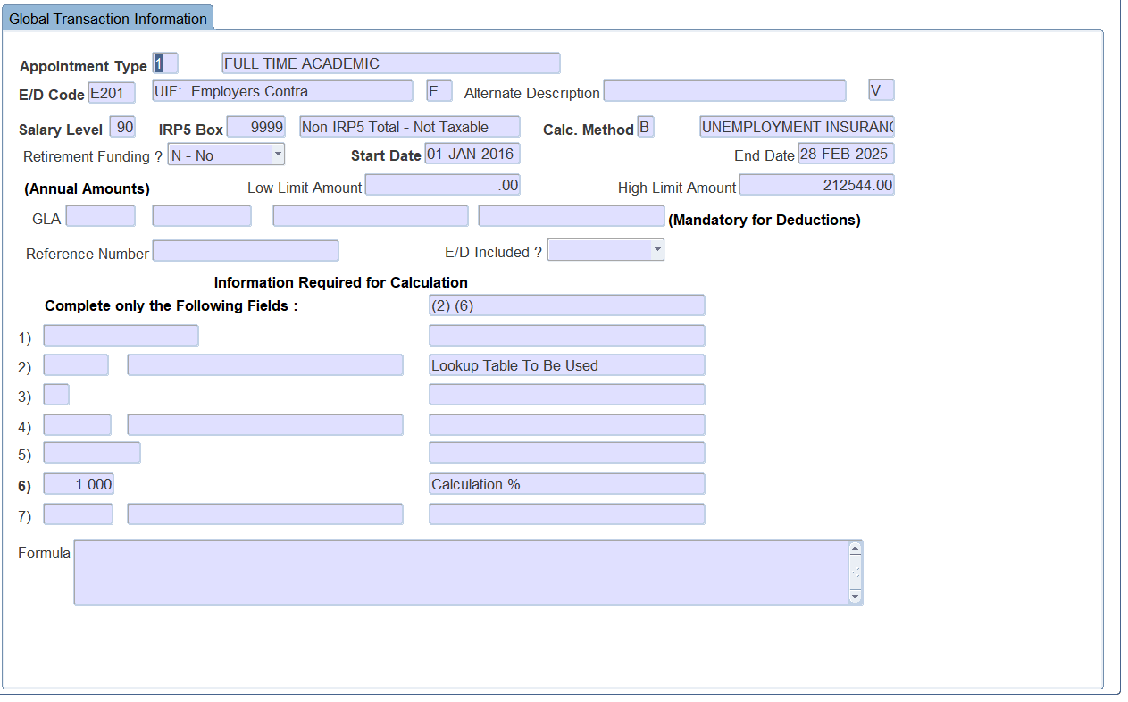
How to create a new ED Code from an existing active ED Code
A new record has now been created, {FPRG-7}
The existing record has been updated with an end date{FPRG-7}

Slide 29
How is UIF, COIDA and SKILLS calculated?

Slide 30





How is UIF calculated?
The Unemployment Insurance Act and Unemployment Insurance Contributions Act apply to all employers and workers, but not to –
workers working less than 24 hours a month for an employer;
learners;
public servants;
foreigners working on contract;
Employees in receipt of an old age pension are, since 07/2/2007, no longer excluded from contributing towards UIF; or
workers who only earn commission
The amount of the contribution due by an employee, must be 1% of the remuneration paid by the employer to the employee
The employer must pay a total contribution of 2% (1% contributed by the employee and 1% contributed by the employer) within the prescribed period
For Unemployment Insurance Fund (UIF) purposes, remuneration generally includes an employee's total earnings, such as salary, wages, bonuses, and overtime, but excludes commission
UIF Ceiling
With effect from 1 June 2021 –
R 17 712 per month
(R 212 544 annually)
Salary, wages, bonuses, and overtime: These are the standard forms of payment an employee receives for their work
Pension, superannuation allowance, or retiring allowance: These are also included as part of the employee's total earnings.
Amounts contemplated in the definition of "gross income" in section 1 of the Income Tax Act: This refers to various forms of income considered taxable, which are also included for UIF purposes
Excluded:
Commission: Commission is specifically excluded from the calculation of UIF contributions
Not Allowed
Excess amounts: Any amounts exceeding the monthly income cap of R17 712 are not included in the calculation of UIF contributions

Slide 31
How is UIF calculated?
Following from this, the Income Tax Act, 1962 (Act, 1962 defines "remuneration" as follows: “Remuneration" means any amount of income which is paid or is payable to any person by way of any salary, leave pay, wage, overtime pay, bonus, gratuity, commission, fee, emolument pension, superannuation allowance, retiring allowance or stipend, whether in cash or otherwise and whether in respect of services rendered, including—
a) any amount referred to in paragraph (a), (c), (cA),(d), (e), (eA) or (f) of the definition of "gross income" in section one of this Act;
b) any amount required to be included in such person's gross income under paragraph (i) of that definition; bA) any allowance or advance, which must be included in the taxable income of that person in terms of section 8(1)(a)(i), other than
an allowance in respect of which paragraph (c) applies;
an allowance or advance paid or granted to that person in respect of accommodation, meals or other incidental costs while that person is obliged to spend at least one night away from his or her usual place of residence in the Republic” and so forth - refer to the relevant act for more information
CALCULATING UNEMPLOYMENT INSURANCE FUND (UIF) CONTRIBUTIONS The calculation of UIF is not a simple matter of applying 1% to the gross pay of an employee.
The calculation of the amount of income that is subject to UIF, is set out in the UIF Act and the Income Tax Act. Please read these paragraphs and make sure you understand them.
The Unemployment Insurance Contributions Act, 2002 states the following: “Subject to subsection (2), the amount of the contribution payable in terms of section 5 –
a) by an employee, must be one per cent of the remuneration paid or payable to that employee by his or her employer during any month; and
b) by an employer in respect of any one of its employees, must be equal to one per cent of the REMUNERATION paid or payable by that employer to that employee during any month.
REMUNERATION means "remuneration" as defined in paragraph 1 of the Fourth Schedule to the Income Tax Act, but does not include any amount paid or payable to an employee –
by way of any pension, superannuation allowance or retiring allowance;
(b) which constitutes an amount contemplated in paragraphs (a), (cA), (d), (e) or (eA) of the definition of "gross income" in section 1 of the Income Tax Act; or
(c) by way of commission”

Slide 32


How is UIF calculated?
Implement UIF
Link correct Remuneration ED codes to UIF on {FPRG-6} as per definition of Remuneration)
Create UIF ED codes to calculate UIF on {FPRG-6}
Use calculation method B Set the low limit to 0 and High limit to the Annual UIF Ceiling
Use calculation method B Set the Calculation % to 1
Link the UIF ED codes to the correct appointment types on {FPRG-7}
The system will now sum the income of ED Codes linked to UIF and calculate 1% ER and 1% EE up to the Ceiling value.
Create ED codes for the Employee, Employer deduction and Contra for the employer deduction
Run the following processes monthly
Payroll Calculation process
Pay UIF deductions over to SARS
Setup UIF Accounts or ED codes in {FPRM-26}
Create the UIF report in {FPRM-28}
Download the UIF file created in the option above in {FPRM-34}
Upload the UIF file for the Dept of Labor or send the file to the Dept of Labor

Slide 33




How is COIDA calculated?
To calculate the Return of Earnings (ROE) for workmen's compensation, you can divide the total payroll for the year by 100 and then multiply by the Nature of Business Risk rate.
COIDA provides extensive coverage to most employees, including:
casual employees
domestic workers
labor broker employees and, in the case of a deceased employee, his / her dependents.
Exclusions:
Independent contractors
self-employed workers
For the period of March 1, 2024, to February 28, 2025, the COIDA (Compensation for Occupational Injuries and Diseases Act) earnings threshold, or ceiling, for calculating assessments is R597,328 per employee per annum
Not Allowed

Slide 34

How is COIDA calculated?
Included in the gross earnings before any deductions are the following:
Overtime of a regular nature, (not intermittent or irregular overtime)
Bonuses of any kind, including incentive bonuses and annual bonuses
Commission, even though the amount may vary from month to month
The cash value of food and quarters supplied to employees as part of a remuneration package. Cash value of fringe benefits such as a company car, free accommodation or accommodation at a reduced rate, etc.
Travel and other allowances paid regularly, as part of the package
Where the employee is remunerated in accordance with a package of benefits, all items forming part of the package, other than employer contributions such as medical aid contributions
Earnings/Drawings paid to working Directors of a Company or Members of a Close Corporation
Excluded are the following:
Payments of a reimbursive nature
Overtime worked occasionally
Payments for specific non-recurring tasks which do not form part of an employee's normal duties
Ex gratia payments
Intangible fringe benefits such as the taxable portion of medical aid/pension contributions by the employer, etc.
Payments to cover special expenses such as subsistence and travelling costs, lunch and costs for business meetings
Travel and other allowances paid occasionally
Profit sharing of Directors and Members.
For COIDA (Compensation for Occupational Injuries and Diseases Act) calculations in South Africa What is included: All regular earnings, including salaries, wages, overtime, bonuses, commission, and the cash value of fringe benefits like company cars or accommodation, in the Return of Earnings (ROE) before any deductions
Earnings are all payments made regularly, before any deductions, whether in money or in kind, to employees
COIDA must be calculated on all income included up to the threshold limit

Slide 35

How is COIDA calculated?
RUN COIDA Reports and afford Payments based on the annual report
{FPRY-8} Generate data for Annual return
{FPRY-9} Generate Annual Return report
{FPRY-10} will supply details for the totals generated in the report above
Implement COIDA
Link correct Remuneration ED codes to COIDA on {FPRG-6} as per definition of Remuneration above)
Create COIDA ED codes to calculate COIDA on {FPRG-6}
Use calculation method 9 Set the Calculation % to the relevant % as per industry .18
Set Calculation field 1 – Reference amount to the COIDA Threshold amount
Link the COIDA ED codes to the correct appointment types on {FPRG-7} Who should be excluded from COIDA calculations :
COIDA cover all workers except workers in private households, people receiving military training and employees of the SA Police Service and the SA National Défense Force.
A schedule to the Act specifies the level of payment applicable to various injuries and
illnesses.
ED codes for the Employer deduction and Contra for the employer deduction
COIDA must be calculated monthly when running your payroll

Slide 36
How is COIDA calculated?
Please note: ADAPT IT is not a registered Tax practitioner or Tax Specialist
We provide the ITS Payroll system that has the ability to accommodate all the tax requirements in all the countries we operate.
Today We are merely sharing information with you regarding UIF, COIDA and SKILLS calculations.
Our Payroll system will afford you the Payroll Officer who is responsible for the ITS Payroll system, the opportunity to indicate on the system which income and deduction codes should be included when calculating UIF, SKILLS and COIDA on {FPRG-6}.
Should you have any doubt as to what should be included please contact your tax consultants.

Slide 37

How is SKILLS calculated?
The employer's contribution is calculated as 1% of leviable amount, which is equivalent to the employee's remuneration for PAYE purposes – in other words, the employee's remuneration less any taxable income deductions.
Skills levy should be paid for all Employee
Employees who are exempt of SDL
• Learnership agreements
• Independent Contractors
• Labor Brokers
Remuneration for SKILLS – what is Tax-deductible remuneration it is defined as the net total of:
• Taxable Earnings
• Plus Perks amounts (Fringe benefits)
• Plus Taxable Company Contributions
• Less Tax-deductible deductions
The sum of this Equals Skills Remuneration (Balance of Remuneration)
The Employer will contribute 1% of the Balance of Remuneration towards the SARS
Not Allowed
No Skills Ceiling exists it is a straight 1% of taxable income

Slide 38
How is SKILLS calculated?
Implement SKILLS
Link correct Remuneration ED codes to Skills on {FPRG-6} as per definition of Remuneration above)
Create SKILLS ED codes to calculate SKILLS on {FPRG-6}
Use calculation method V Set the Calculation % to 1
Link the SKILLS ED codes to the, correct appointment types on {FPRG-7}
The system will now sum the income of ED Codes linked to SKILLS and calculate 1% ER contribution
Create ED codes for the Employer deduction and Contra for the employer deduction
Pay SKILLS deductions over to SARS monthly

Slide 39

How is SKILLS calculated?
Implement SKILLS
Link correct Remuneration ED codes to Skills on {FPRG-6} as per definition of Remuneration above)
Create SKILLS ED codes to calculate SKILLS on {FPRG-6}
Use calculation method V Set the Calculation % to 1
Link the SKILLS ED codes to the, correct appointment types on {FPRG-7}
The system will now sum the income of ED Codes linked to SKILLS and calculate 1% ER contribution
Create ED codes for the Employer deduction and Contra for the employer deduction
Pay SKILLS deductions over to SARS monthly

